Slide 1

Torch Award Guidebook
Today’s Students. Tomorrow’s Business Professionals.

Slide 2
Objective
The Torch Awards is a way to show your involvement in your community and Business Professionals of America
Earn recognition for all of the things you already stay active with

Slide 3
Recognition
You can be recognized at all or any level of our organization. You do not need to obtain prior awards to be recognized at the National Leadership Conference!
Local – Executive – 10 points per category
Region – Diplomat – 30 points per category
State – Statesman – 50 points per category
National – Ambassador – 70 points per category

Slide 4
Earning Points
Activities will count towards points in 1 of 7 categories
Log points into an online system
Simple activities that you may already be completing will earn you points
Attending Church
Participating in 4H
Going to a parade
Leading in the Pledge of Allegiance
Attending a region conference
Donating Blood

Slide 5
The Torches
There are 9 Torches in 7 activity divisions, each of which will need points to obtain an award
Leadership
Service
Cooperation
Knowledge
Friendship
Love, Hope, Faith
Patriotism

Slide 6
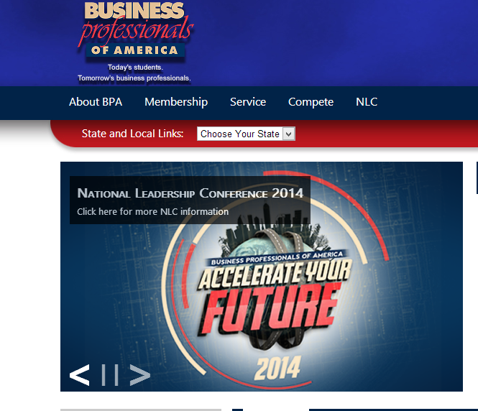
Accessing the Online System
Receive your username and password from your local advisor- they created this when they registered you for membership
Go to bpa.org and move your mouse over the Service tab

Slide 7
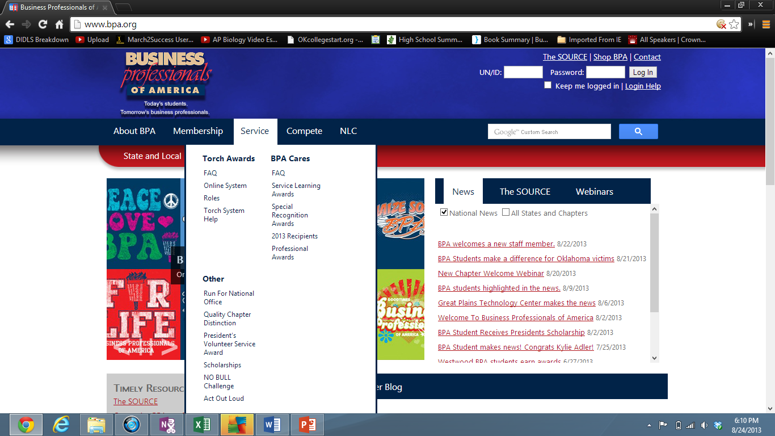
Your Account
Go to the left side of the drop down menu under Torch Awards and click on Online System

Slide 8
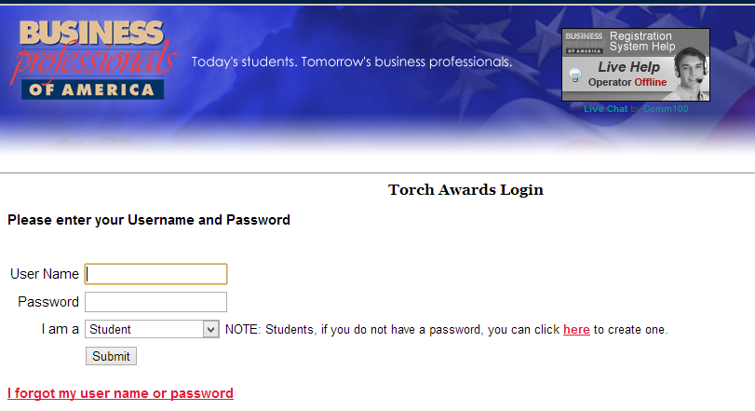
After clicking online system, you will enter your username and password in the two tabs

Slide 9
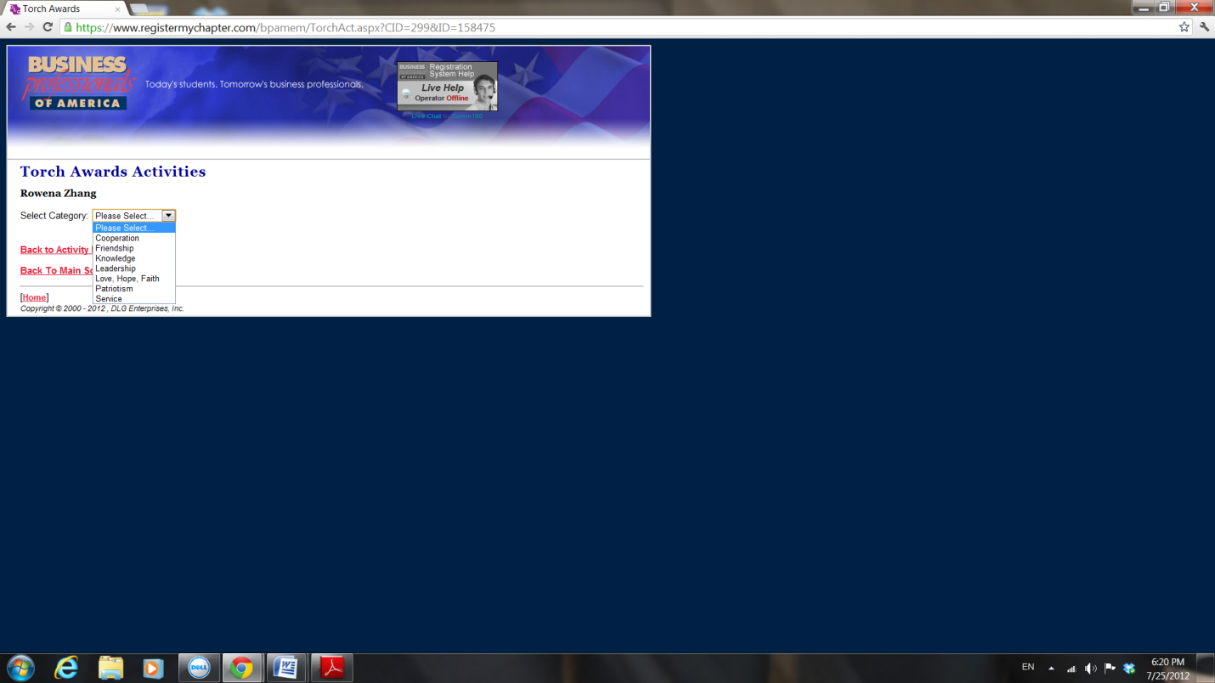
At this point, you will be able to explore the different categories and activities
Click a torch category to add a new activity

Slide 10
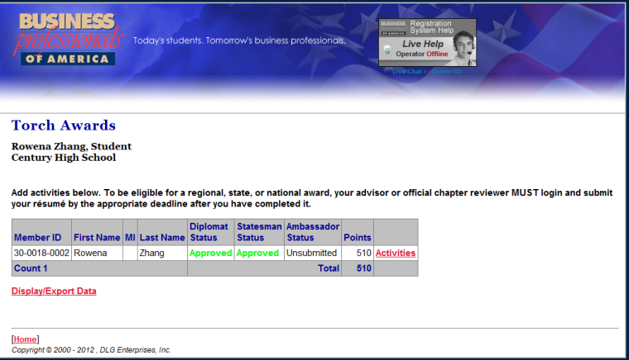
Once logged in, click a gray box with Activities on the right side
The next screen will show all of your activities, if you have any. Scroll to the very bottom and click on Add Activity

Slide 11
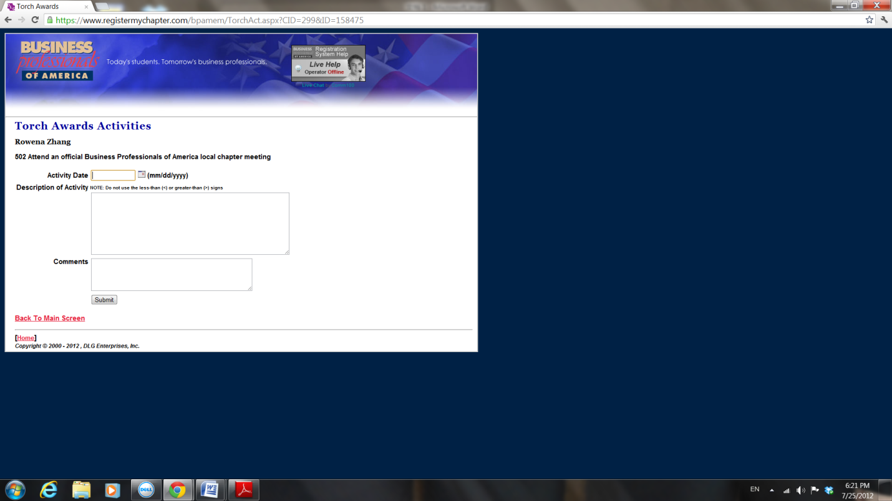
Be sure to be detailed and start each activity with a past-tense verb
The system will tell you the number of times you are able to use each activity. Be sure not to exceed this

Slide 12

Torch Tips
Activities will be easier to complete if you do so as a chapter or with friends
If you record your activities throughout the year, you will be an Ambassador by the spring deadline
Go through the Torch Award Handbook at the beginning of the year to decide which activities you will complete
Be proud of not only the Torch Award itself, but the activities you have done to complete it
Check out our Facebook and Twitter profiles on #TorchTuesday for reminders on how to obtain your Ambassador Award

Slide 13
"The Torch Awards program is designed to highlight the elite members within this great organization. Through the torch program I proved I was a leader, showed service to my school and community, I used cooperation by working with others, made friendships within my chapter and other BPA members around the United States, gained knowledge of the BPA organization, defined my love, hope, and faith, and displayed patriotism for our country.”
Kaylee Brandt
2013 Ambassador of the Year.

